Slide 1


World Tour Research Paper Development Programme 2024
Thursday 23 May 2024 – Online at 2pm Central Africa Time
7am (CST) | 8am (EST) | 1pm (GMT) | 1pm (CET; WAT) | 2pm CAT | 3pm (EAT)
There is no charge for this event.
AGENDA
PART 1: Open session
Editors’ panel discussion at 14:00
African Scholars’ panel discussion at 15:35
PART 2: By invitation only
Paper development one-on-one mentoring at 16:45
PRME Chapter Africa – we support the Sustainable Development Goals
For more information please click HERE.

Slide 2
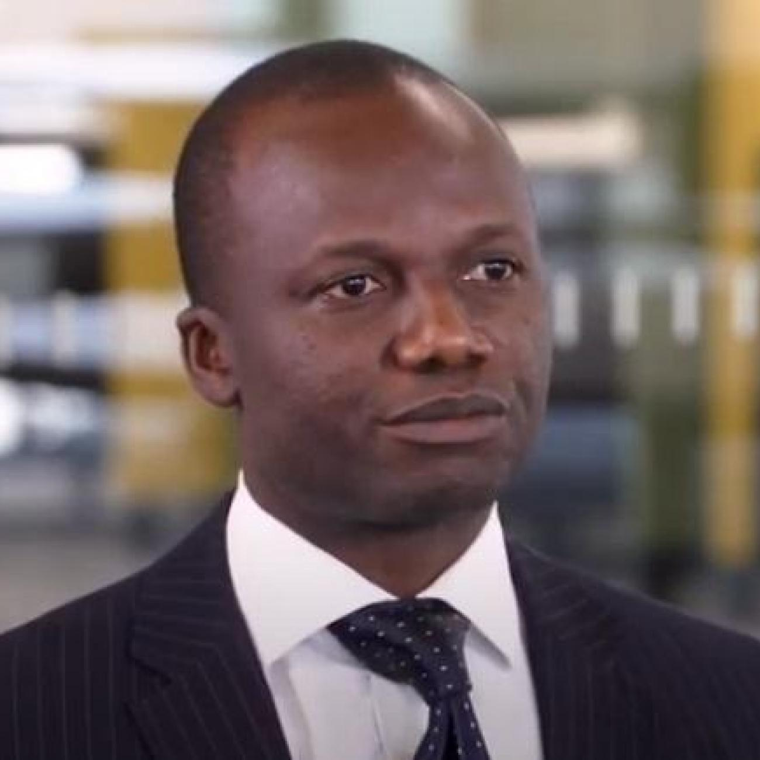
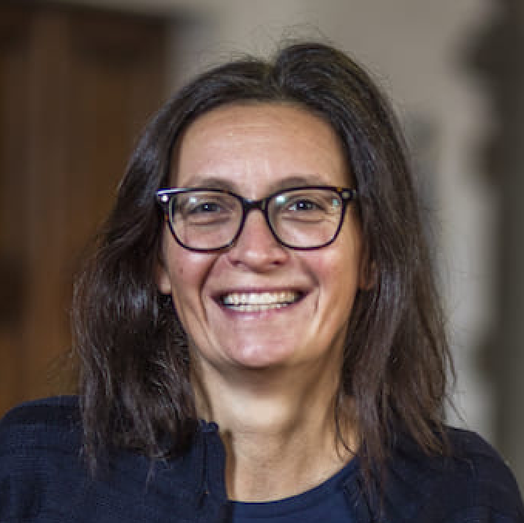
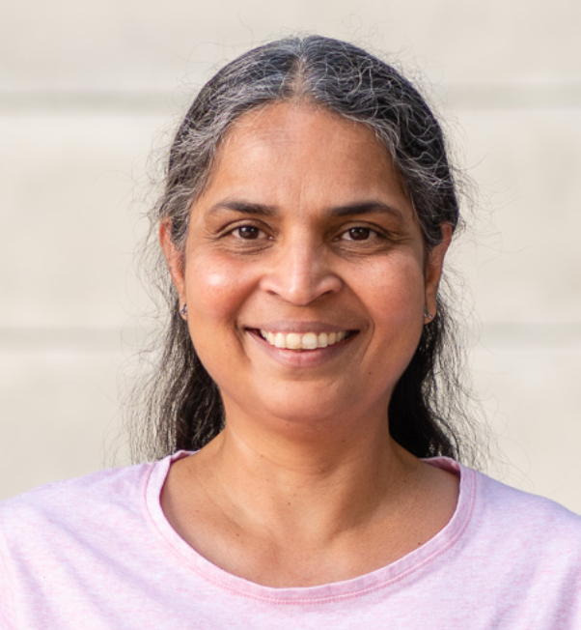
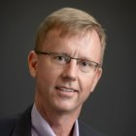
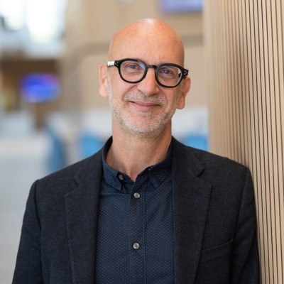
World Tour Research Paper Development Programme 2024
Thursday 23 May 2024 – Online at 2pm Central Africa Time
7am (CST) | 8am (EST) | 1pm (GMT) | 1pm (CET; WAT) | 2pm CAT | 3pm (EAT)
There is no charge for this event.
PRME Chapter Africa – we support the Sustainable Development Goals
Collins Ntim | Associate Editor, Business & Society
Elisa Giuliani | Editor, Research Policy
Premilla D’Cruz | Section Editor, Journal of Business Ethics
Jonathan Doh | Consulting Editor, Journal of Management Studies
Editors’ panel discussion
For more information please click HERE.
Andrew Crane | Moderator | former Editor Business & Society

Slide 3
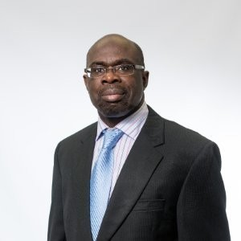
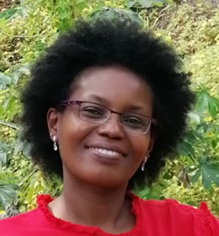
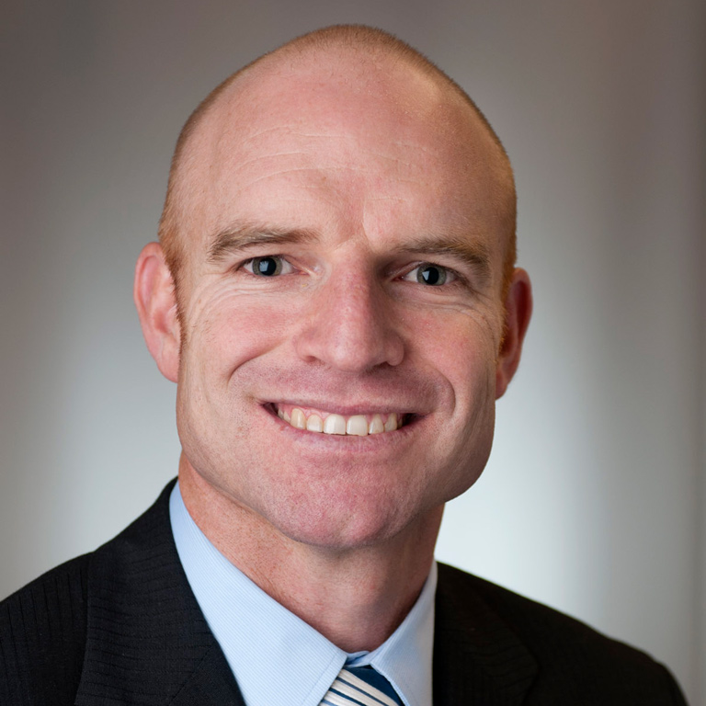
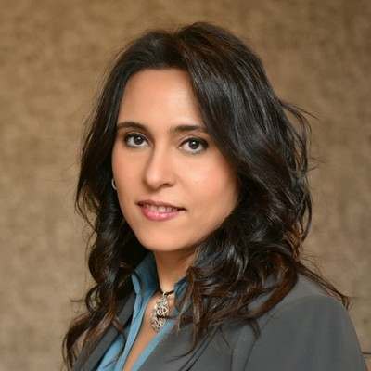
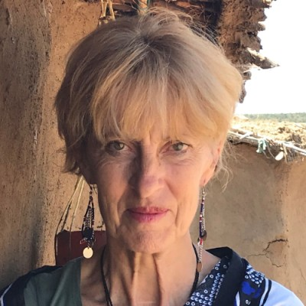
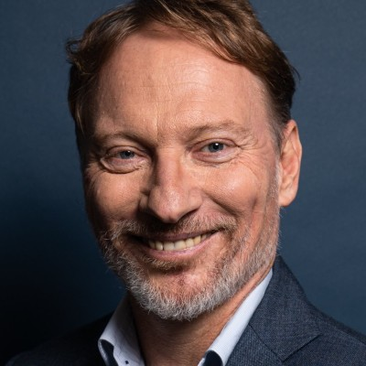
World Tour Research Paper Development Programme 2024
Thursday 23 May 2024 – Online at 2pm Central Africa Time
7am (CST) | 8am (EST) | 1pm (GMT) | 1pm (CET; WAT) | 2pm CAT | 3pm (EAT)
There is no charge for this event.
Moses Acquaah | Chair, African Academy of Management (AFAM)
Judy Muthuri | Nottingham University Business School
Greg Fisher | Kelley School of Business
PRME Chapter Africa – we support the Sustainable Development Goals
African Scholars’
panel discussion
For more information please click HERE.
Sherwat Elwan Ibrahim| Moderator | Chair,PRME Chapter Africa
Jacqueline McGlade | Strathmore University
Ralph Hamann | Graduate School of Business, Cape Town

